Slide 1
Transparency is Power Campaign

Slide 2
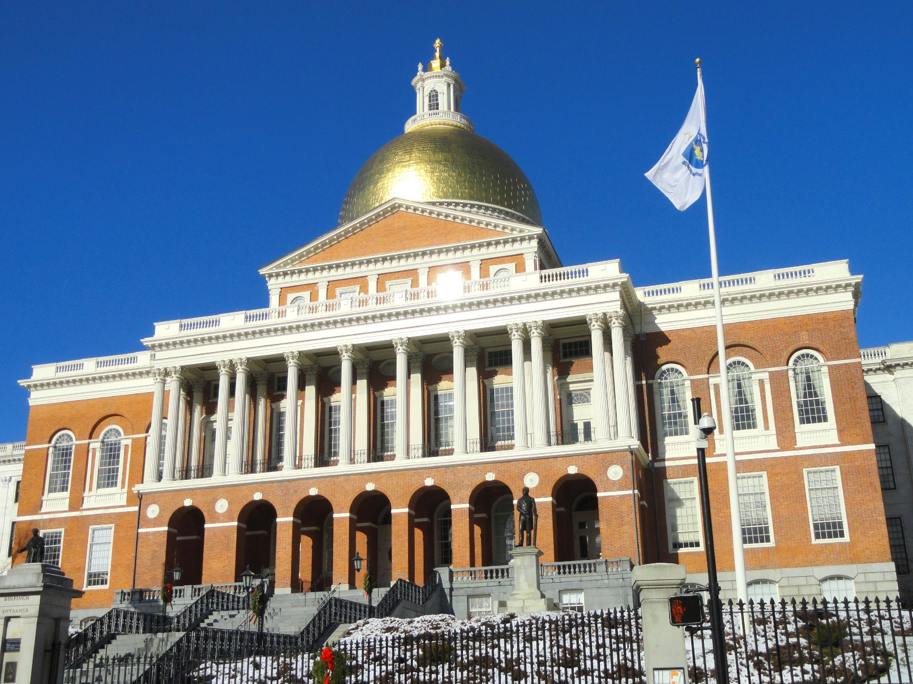
The Massachusetts State House is Broken
Open States Project Scorecard¹
Legislation with Broad Public Support |  | Years No Action
 | Safe Communities Act | 8
 | Comprehensive Climate Crisis Legislation | 12
 | Same Day Voter Registration | 16
 | Progressive Taxation | 20
Grade: F
(1) Source: Open States (https://ballotpedia.org/Open_States%27_Legislative_Data_Report_Card)

Slide 3
How the System Breaks Down
This process is governed by a rulebook that is written by state legislators themselves!
The Legislative Process in Massachusetts
House and Senate Rulebook
Floor Vote in the Senate
Secretive Committee Votes
Bills go to die in darkness
MA in minority of states with secretive committees (26 with public votes)
Off-the-Record Floor Votes
In the House of Representatives, 10% must stand for a recorded vote
Most states have a lower threshold
No Time to Review Final Legislation
1
State Legislator Files a Bill
1
Governor Signs into Law
Committee Vote
2
2
Floor Vote in the House
3

Slide 4
Proposed Rules Amendments
Our Demands:
Rules Changes for Legislative Session
Campaign Endorsements
Rule 1: All committee votes and testimony are public
Rule 2: Bills public for 72 hours prior to final vote
Rule 3: Threshold for public floor vote reduced to 8 state reps
160

Slide 5
State House Fails its Constituents
Example 1: Criminal Justice Reform
Issue | State House has Failed¹
Criminal Justice Reform | Rep. Smitty Pignatelli voted against the recent police reform bill, preventing it from having a veto-proof majority, explaining: “to really sift through a 129-page report that had been negotiated the previous four months by six people, I would have loved more time.” Rep. Barrett has highlighted how “Thirty years ago, when I first advocated reform, it never happened,...The same people who were responsible for the death of Timothy Shepard were then put back in charge of the training programs when they were revamped.” Basic reform should not take 30 years and risk being vetoed.
(1) Source: https://www.berkshireeagle.com/news/local/police-reform-compromise-goes-to-baker-without-veto-proof-majority/article_754f081c-34fa-11eb-a33d-bf8c530673be.html

Slide 6
State House Fails its Constituents
Example 2: Protecting Immigrants from Trump’s Policies
Issue | Close to Home | State House has Failed
Immigrants Rights | There are an estimated 10,000 immigrants in the Berkshires¹ In 2019, Great Barrington Police assisted ICE in detaining an immigrant worker.² 15 states and D.C. offer driver’s licenses to all qualified drivers³ | Trust Act (2015): Blocks state and local police from acting on behalf of federal immigration officers Under “study” since 2016 Safe Communities Act (2017): Blocks state and local police from acting on behalf of federal immigration officers Under “study” since 2018 Work and Family Mobility Act (2019): Enables all qualified state residents to apply for a driver’s license Stuck in Ways and Means Committee
California | New Jersey
Colorado | New Mexico
Connecticut | New York
Delaware | Oregon
Hawaii | Utah
Illinois | Vermont
Maryland | Washington
Nevada
(1) Source: Berkshire Immigrant Center
(2) Source: https://theberkshireedge.com/in-frightening-display-ice-agents-arrest-immigrant-worker-on-main-street/
(3) Source: https://www.ncsl.org/research/immigration/states-offering-driver-s-licenses-to-immigrants.aspx

Slide 7
State House Fails its Constituents
Example 3: Tackling the Climate Crisis
Issue | Residents Favor Leadership¹ | State House has Failed²
Climate Change |  | No major climate change legislation passed since 2008 Global Warming Solutions Act The Berkshires are already seeing the impacts of increased drought and storms on farming and the foliage season. The climate roadmap put forth by the Massachusetts House of Representatives in August 2020 transitions to 100% renewable energy by 2090!
MA Should Act in Response to Climate Change
Ahead of Other States
At Same Time
Take No Action
Wait for Others
Unsure
(1) Source: Mass Inc. Polling Group (https://static1.squarespace.com/static/5eb9fa2f8ac4df11937f6a49/t/5f6905f6d4ca4216c3a2a3b3/1600718328379/Slides+2020+01+Barr+Climate+Change.pdf)
(2) https://commonwealthmagazine.org/opinion/house-takes-baby-steps-on-climate-change/

Slide 8
Our Grassroots Solution
Our Strategy
Accelerating the Rate of Transformative Change
Build District Teams across the state to stand up for transparency
Train constituents on healthy constituent-legislator relationship and strategize together
Build constituent power by holding meetings with state legislators
Escalate awareness in advance of the January / February rules vote
Advocacy
Years of Delay
Lack of
Transparency
Corporate

Slide 9
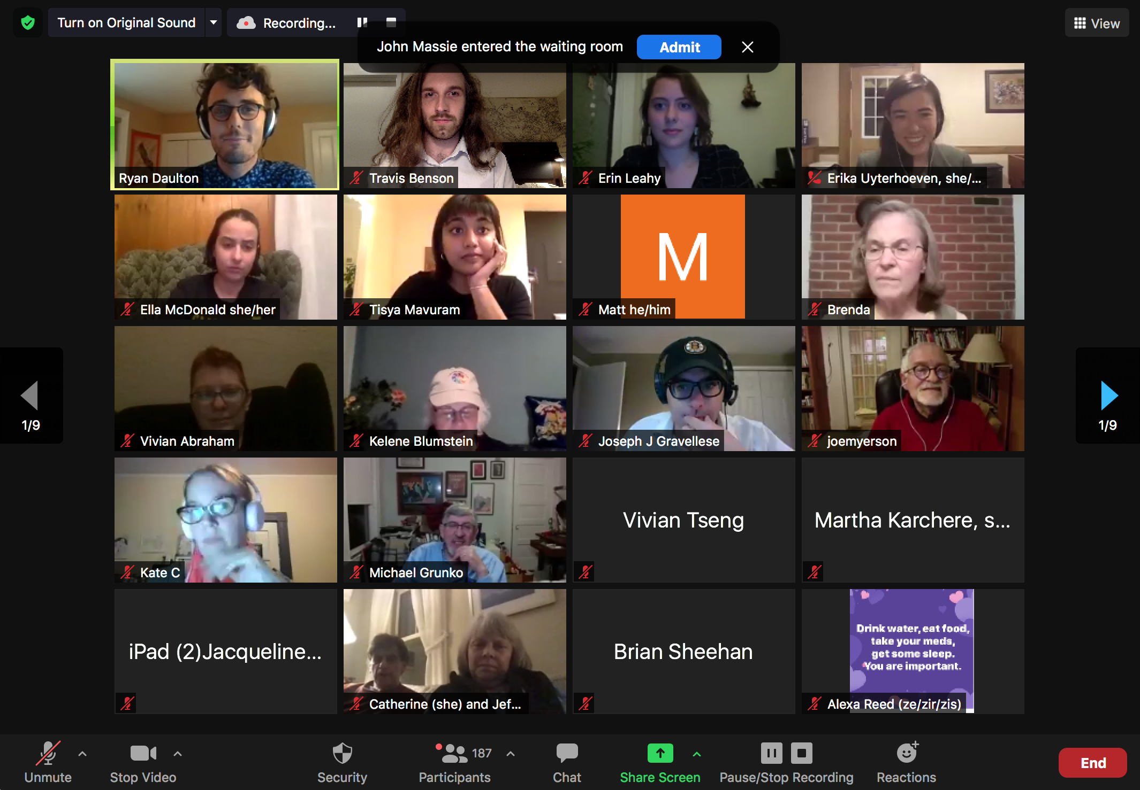
Campaign Update
Organizing Metrics
+1,000 sign ups to join district teams
Target Districts: 75
11 Vote Commitments
20 Meetings Scheduled
24 Scheduling (next 2 weeks)
20 Meetings January
50 teams with 5 or more people

Slide 10
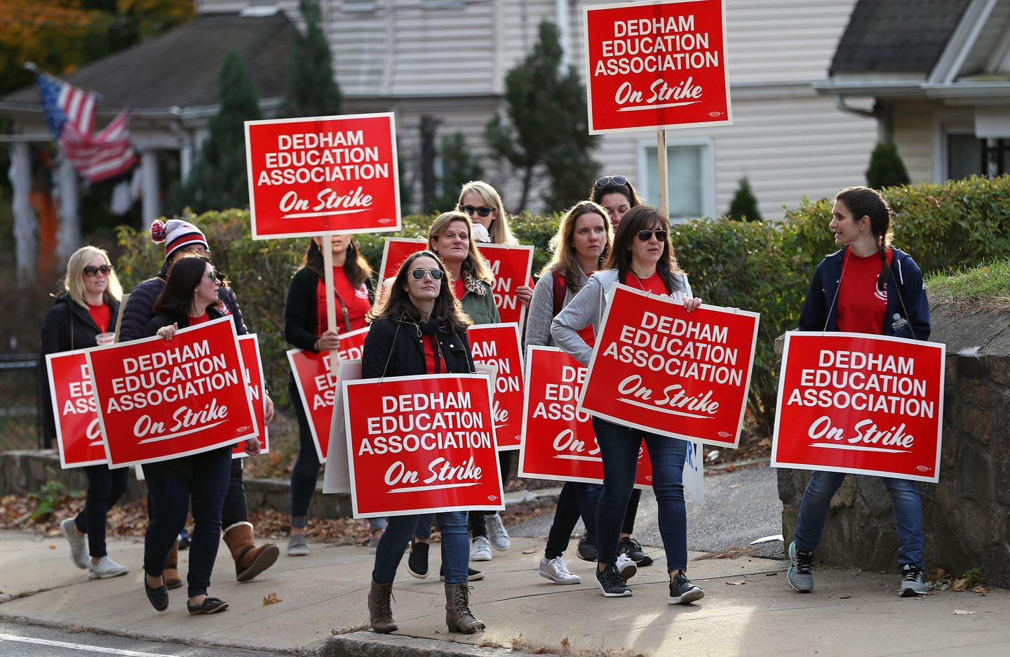
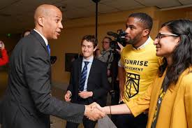
Escalate Pressure through Rules Vote
Constant and Escalating Pressure at District Level and Statewide
Rules Vote in
January 2021
Mid January
Week of Action with Endorsing Organizations
Constituent-Legislator Meeting with
Additional Constituents
Phone Banking Friends and Community Members
Initial
Constituent-Legislator Meeting

Slide 11
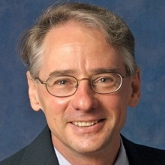
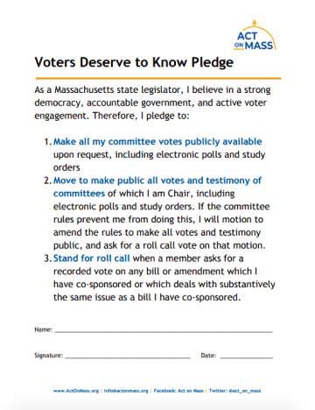
History behind the Campaign
January 2019: Most Recent Vote on House and Senate Rulebook
State Rep. Hecht filed amendments to provide 72 hours to review final legislation and to make committee votes and written materials public
The amendments were voted down 55-101 and 49-109, respectively
September 2019: Act on Mass launches Voters Deserve to Know Pledge
Act on Mass launched the pledge asking state legislators to:
Make their committee votes public
Make all votes and testimony of committees they chair public
Stand for publicly-recorded votes on bills and amendments they co-sponsor
November 2020: Act on Mass Leads on Ballot Question 4
Ballot Question 4 (non-binding) is on the ballot in 16 districts allowing voters to directly voice support for transparency
“Shall the representative for this district be instructed to vote in favor of changes to the applicable House of Representative rules to make the results of all the votes in that body’s Legislative committee publicly available on the Legislature’s website?”
Voters Deserve to Know Pledge Signers:
22 State Legislators

Slide 12
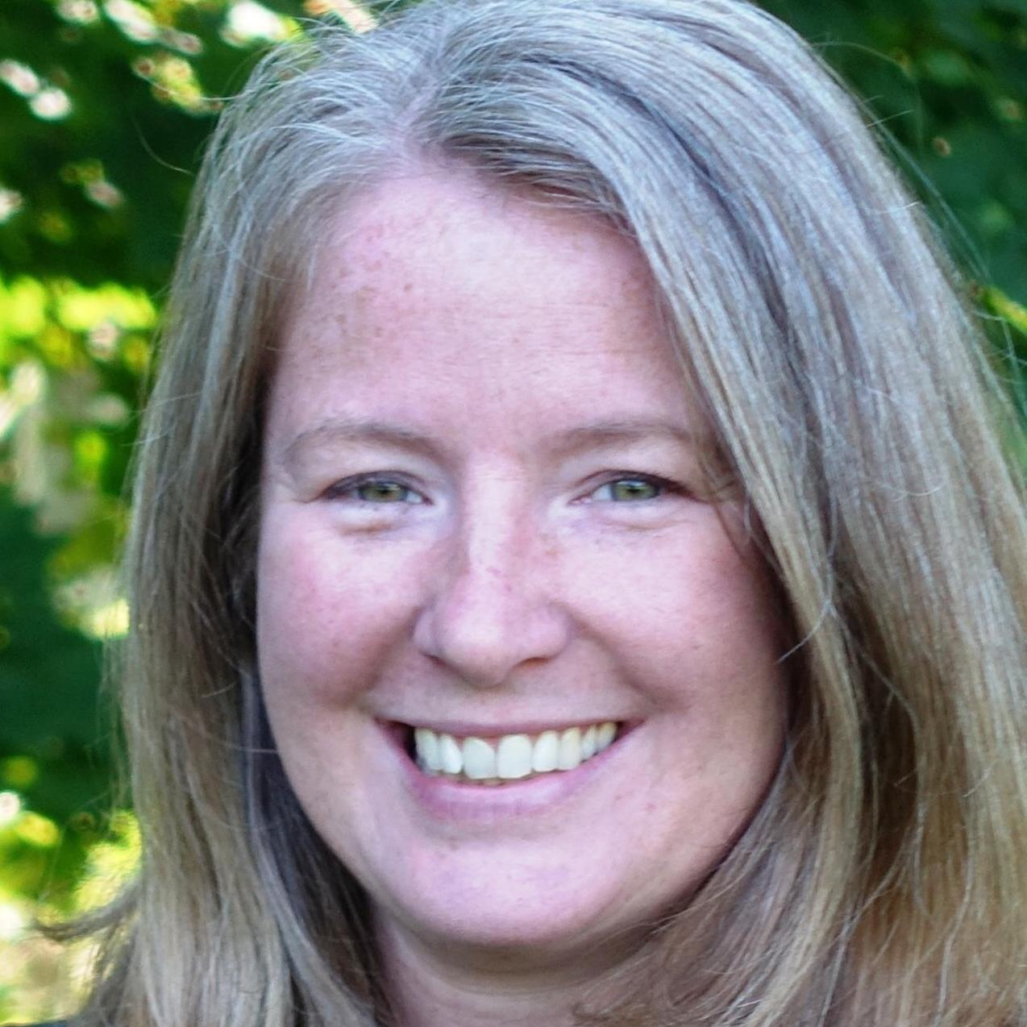
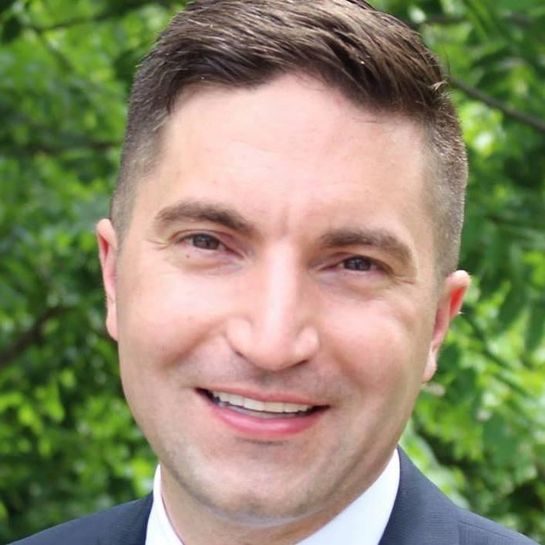
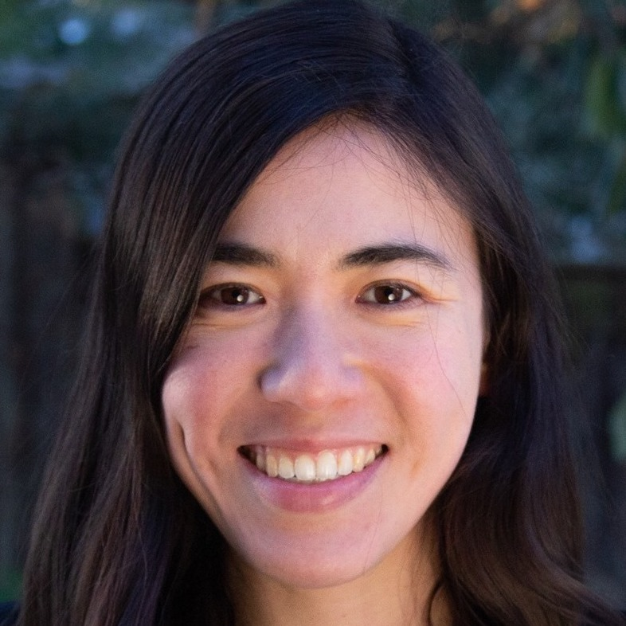
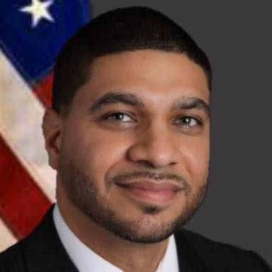
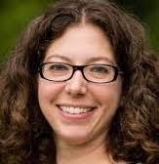
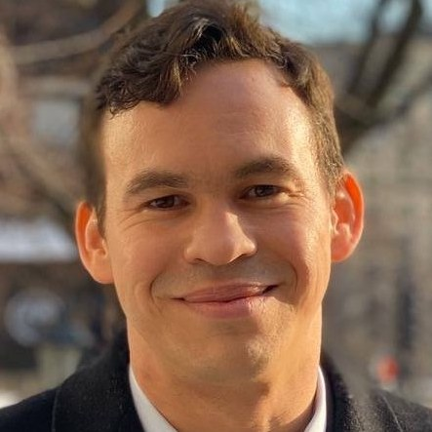
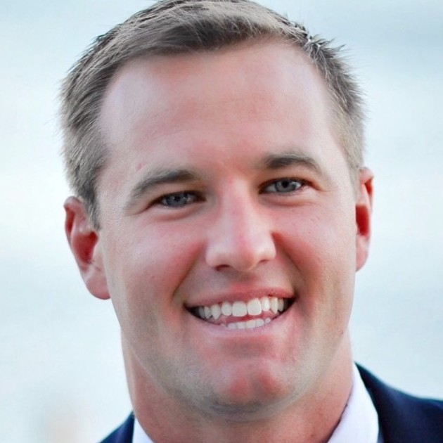
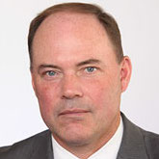
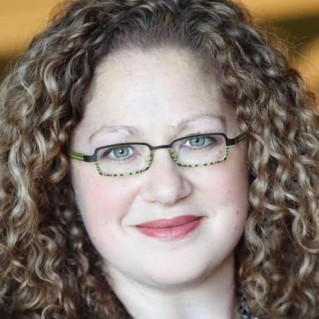
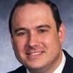
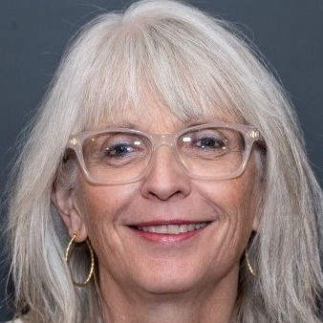
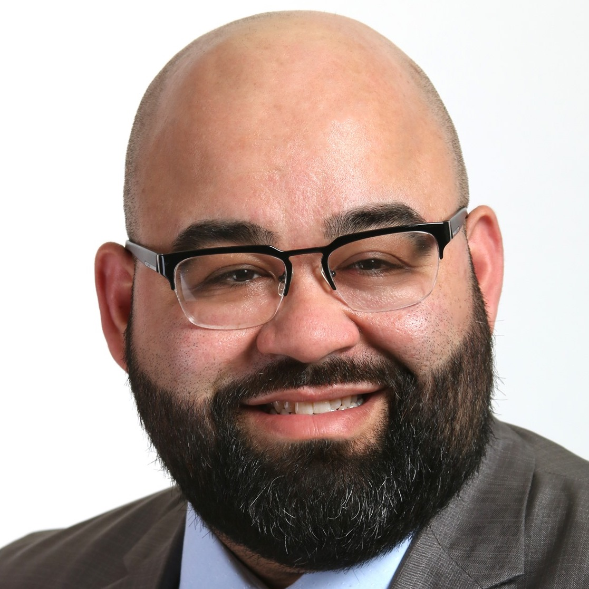
Voters Deserve to Know Pledge
Incumbent Pledge Signers (11)
New Pledge Signers (7)
Maria Robinson
Framingham
Lindsay Sabadosa
Northampton
Tami Gouveia
Acton
Jack Lewis
Framingham
Erika Uyterhoeven
Somerville
Steve Owens
Watertown
Orlando Ramos
Springfield
Adam Scanlon
North Attleboro
Natalie Higgins
Leominster
Danillo Sena
Acton
Patrick Kearney
Scituate
Nika Elugardo
Jamaica Plain
Vanna Howard
Lowell
Mike Kushmerek
Fitchburg
Meg Kilcoyne
Northborough
Senate Signers
Becca Rausch
Needham
Jamie Eldridge
Acton
Sue Moran
Falmouth
Adam Gomez
Springfield
Mike Connolly
Cambridge
John Rogers
Norwood
Russell Holmes
Mattapan

Slide 13
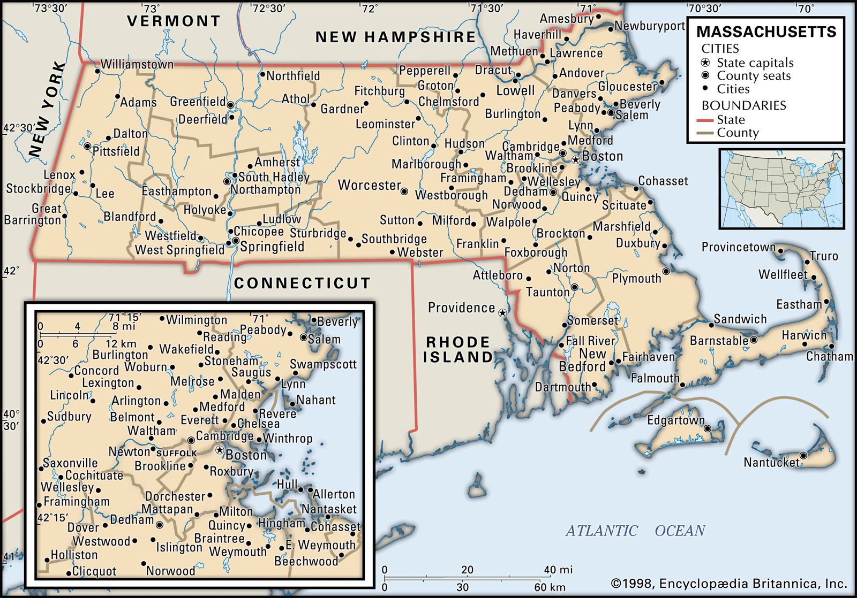
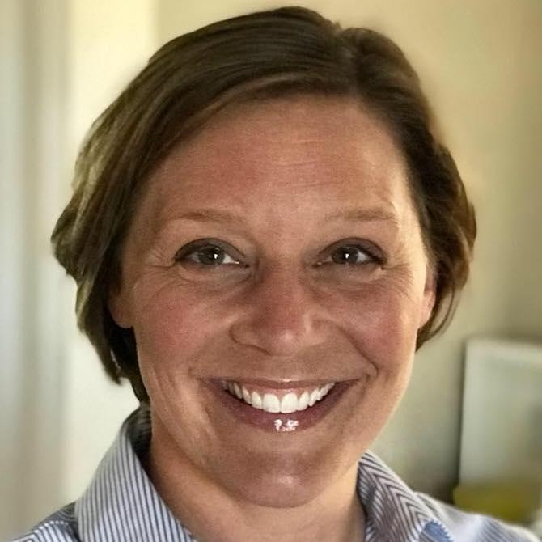
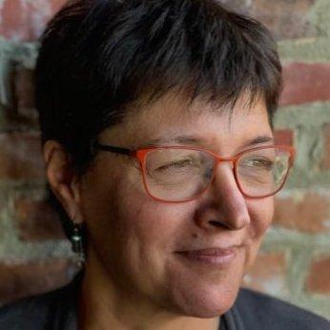
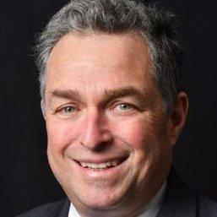
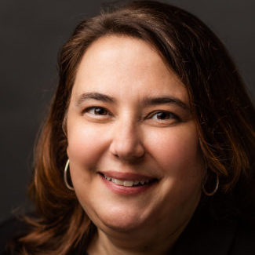
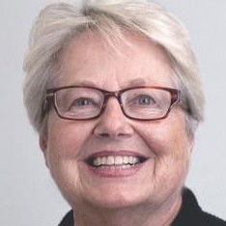
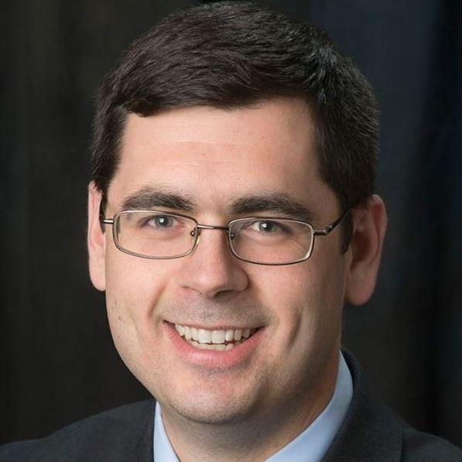
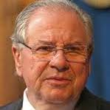
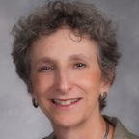
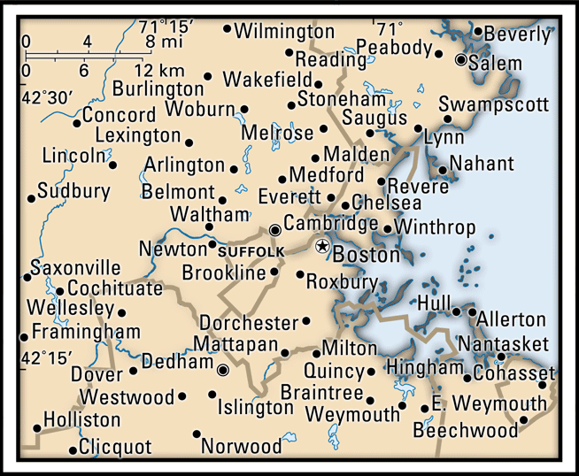
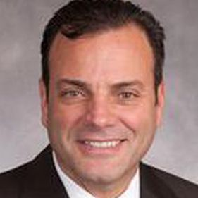
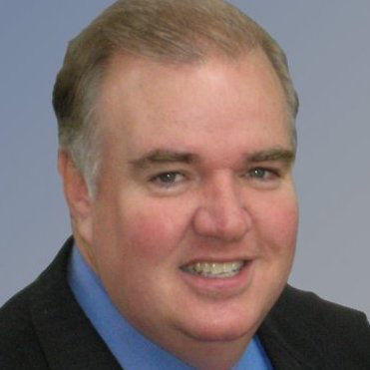
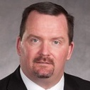
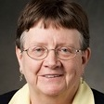
Ballot Question 4 Results
Ballot Question 4: Shall the representative for this district be instructed to vote in favor of changes to the Legislature's rules that would make the results of all votes in Legislative committees publicly available on the Legislature's website?
Natalie Blais
Sunderland
Mindy Domb
Amherst
Kenneth Gordeon
Bedford
Ann-Margaret Ferrante
Gloucester
Kay Khan
Newton
Dan Carey
Easthampton
Public Support for Transparency
Bob DeLeo
Winthrop
Steve Owens
Watertown
Ruth Balser
Newton
Erika Uyterhoeven
Somerville
Paul McMurtry
Dedham
Kevin Honan
Allston Brighton
Mike Moran
Allston Brighton
On Ballot in
16 Districts
Nika Elugardo
Jamaica Plain
Tommy Vitolo
Brookline
Liz Malia
Jamaica Plain

Slide 14
Join Your District Team
Organize in your community as a District Team member
Organize constituents in your district
Strategize with District Team members on how to pressure your representative
Act on Mass training on deflection tactics legislators use
Attend a pressure meeting with your state legislator
Escalate
1
Requirements:
You are excited to organize in your community
You are eager to meet with your legislator to pressure for rules changes and a functioning democracy
Act on Mass will provide 100% of trainings and support
Belief in a healthy democracy, an anti-racist agenda, a just economy, and a livable planet
actonmass.org/the-campaign

Slide 15
District Team Contacts
1st Berkshire (Rep. John Barrett) and 3rd Berkshire
(Rep. Tricia Farley-Bouvier) - Sophie Coyne (sophie@actonmass.org)
2nd Berkshire (Rep. Paul Mark) and 1st Franklin (Rep. Natalie Blais) - Ryan Daulton (ryan@actonmass.org)
4th Berkshire (Rep. Smitty Pignatelli) - Nate Lapointe (nate@actonmass.org)
Requirements:
You are excited to organize in your community
You are eager to meet with your legislator to pressure for rules changes and a functioning democracy
Act on Mass will provide 100% of trainings and support
Belief in a healthy democracy, an anti-racist agenda, a just economy, and a livable planet
actonmass.org/the-campaign

Slide 16
Help Promote the Campaign
@act_on_mass
www.facebook.com/act.on.massachusetts
@act_on_mass

